Slide 1
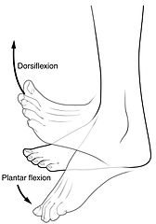
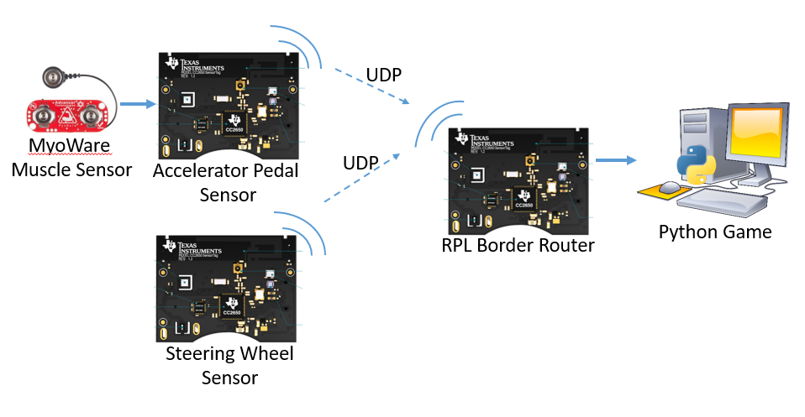
Gamification of Rehabilitation Using Muscle Sensors
Michael Redpath, Michael Garthe, Callum Sinclair, Athon Milane – Group L
PROJECT AIMS
Develop a car racing controller to assist with Human Rehabilitation
Games are a proven method to help patients rehabilitate.
Games have been shown to improve both physical and cognitive ability.
Interface with muscle sensors
In this project, muscle sensors have been used to measure dorsiflexion and plantarflexion rehabilitation exercises.
Figure 1: Dorsiflexion and plantarflexion exercises (Cheprasov, 2018)
The users muscle activation will be used to control the computer game.
Develop a reliable advanced embedded system
The TI Sensortag’s accelerometer and gyroscope will be used in addition to the muscle sensors. This sensor data will be combined and machine learning will be applied to produce a reliable game controller.
SYSTEM OVERVIEW
MyoWare Muscle Sensors
The muscle sensors can detect muscle activation by measuring the electromyography signals emitted by your muscles!
[Something about ADC output]
[Possible graph of output waveform or sensor positioning]
A muscle sensor will be placed on the leg to detect the accelerator pedal.
TI SensorTags
[Mention on board Accelerometer and Gyro]
[Mention ADC]
Wireless Communication
[Send data via UDP to RPL – read by python script]
Sensor Fusion
[Fusing Accelerometer and Gyro values?]
[Fusing Accelerometer and MYO values?]
Machine Learning
[ML on MYO Values]
Python Games
[Python program used to interface with a number of different games/ one specific game]
Figure 1: System Overview

